Slide 2
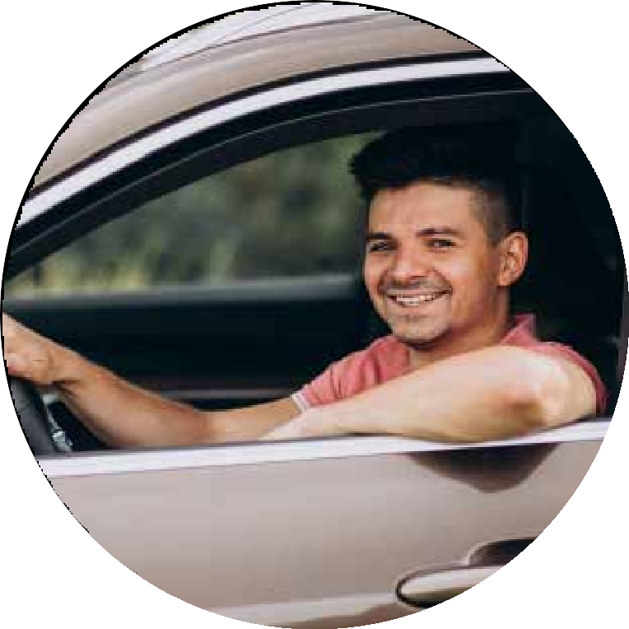
About Us
M R TOURS & TRADERS: Your Reliable Taxi Partner Across India
Experience, Reliability, Affordability
M R TOURS & TRADERS, a trusted name in taxi services since 2005, offers reliable and affordable travel solutions across India. With over 100 cities served and a fleet of 200+ taxis, we ensure a smooth journey wherever you go.
Your Comfort is Our Priority
Our dedicated team, both in offices and on the road, understands your needs. We offer a diverse range of cabs, from economical to luxury, all prioritizing cleanliness and reliability at competitive prices.
Beyond Taxi Rentals
M R TOURS & TRADERS goes beyond just taxis. We collaborate with hotels, arrange local sightseeing, and provide outstation travel and tour packages. Trusted by companies like Reliance and TATA, we offer comprehensive travel solutions.
Convenience at Your Fingertips
M R TOURS & TRADERS utilizes cutting-edge technology to ensure the lowest prices and well-maintained vehicles driven by professional chauffeurs. Our 24/7 online reservation system provides convenient booking nationwide.

Slide 3
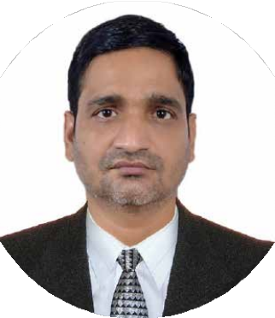
The CEO’s Promise
A Team Fueled by Passion and Diversity
Our team thrives on a vibrant blend of youthful energy, diverse skills, and rich cultural backgrounds. This dynamic is fostered by our flat organizational structure, which encourages seamless collaboration across leadership, marketing, business operations, business intelligence, and dedicated customer support. With nearly 150 passionate members, we operate daily with respect, discipline, and a shared commitment to delivering exceptional service.
KAPIL JHA
CEO
Ownership & Accountability | Organisation Culture & Service

Slide 4
Vision
To become the premier provider of safe, comfortable, and affordable taxi services. We aim to achieve this vision through the synergistic combination of cutting-edge technology and unparalleled human support, ensuring that every customer experience exceeds expectations.
SAFE
COMFORT
AFFORDABLE
EXCELLENCE
COMPLIANCE
Mission
To continually prioritize our customers above all else and to accomplish this by consistently embodying integrity, fairness, and unwavering adherence to regulations in every aspect of our operations.
Safety | Comfort | Respect | Reliability & Punctuality

Slide 5
OUR PIONEERS & VALUED CUSTOMERS
Cleanliness & Comfort | Service with Excellence | Sustainability Initiative

Slide 6
OUR COMMITMENT WHO COME FIRST?
Special People
Expecting Mothers
My Customer
Children & The Elderly
Ladies
Gentlemen
Customer 1st
My Taxi
My Company
Then me
Growth Strategies | Safety & Security | Customer Satisfaction

Slide 7
Booking Process
Please visit our company website
www.mrtourandtraders.com
Travel plan discussion with the Guest from MRTT Customer Service for final allocation of the Taxi
Fill the request form
Welcome and Greetings through Email/whats app & sms to the Guest and respective administrator along with trip ID
Confirmation of Taxi allocation along with Taxi/type/no, chauffeur name and contact details, reporting time
,helpline 24X7 along with primary information about the welcome kit to guest through email/whats app
Ownership & Accountability | Organization Culture

Slide 8
How to reach us for booking?
Whatsapp:
7982591079
Phone call:
011-49842991
Email ID:
cabbooking@mrtours.in
Ownership & Accountability | Organisation Culture & Service

Slide 9
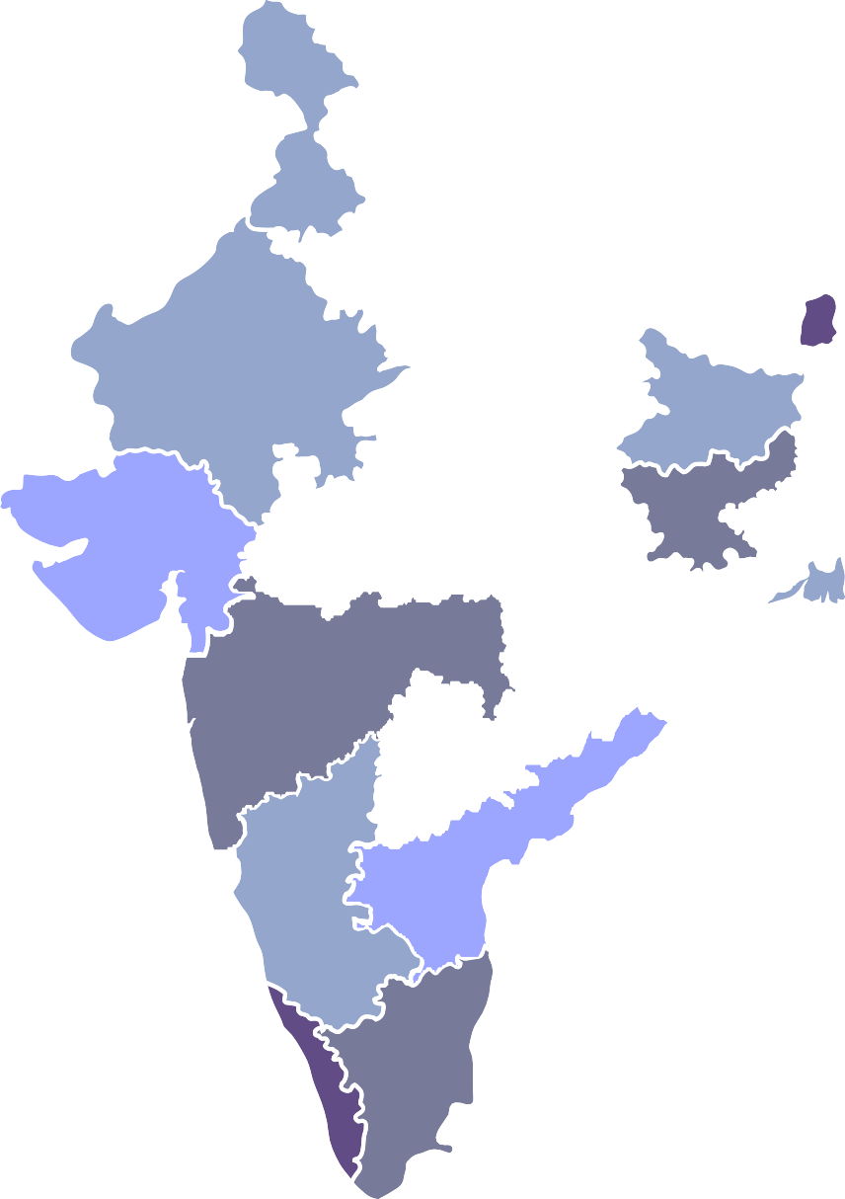
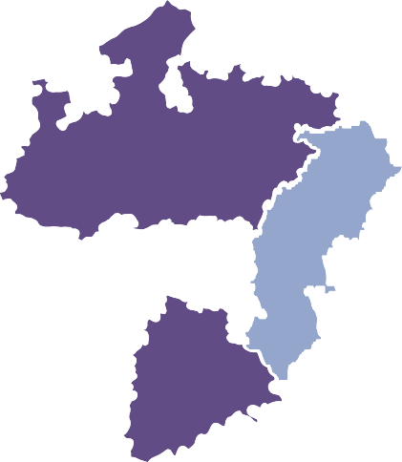
Service locations
CHANDIGARH CHANDIGARH/ MOHALI
HIMACHAL PRADESH
BADDI / KANGRA / SHIMLA
HARYANA AMBALA/ FARIDABAD/ GURGAON/ KARNAL/ PANIPAT
ASSAM DIBRUGARH / GUWAHATI
DELHI
DELHI NCR
BIHAR
PATNA/ MUAFFARPUR/ GAYA/ BIHARSHARIF/ DARBHANGA/ BHAGALPUR
GUJARAT AHMEDABAD / GANDHINAGAR
/ RAJKOT / BHARUCH / ANAND
/ JAMNAGAR / BHAVNAGAR / VADODARA / SURAT / VAPI /
DAMAN / MEHSANA
JHARKHAND
RANCHI / JAMSHEDPUR / BOKARO
GOA PUNJIM / MADGAON
CHATTISHGARH
RAIPUR/ BILASPUR
ANDHRA PRADESH
VIJAYWADA / GUNTUR
/ TIRUPATI / NELLORE / VISHAKHAPATNAM
KARNATAKA
BANGALORE / MYSORE
/ MANGALORE / HUBLI / BELLARY
Safety | Comfort | Respect | Reliability & Punctuality

Slide 10
Service locations
UTTARAKHAND
DEHRADUN/ HARIDWAR/ RISHIKESH/ HALDWANI/ RUDRAPUR
PUNJAB
MOHALI/ BHATINDA/ AMRITSAR/ LUDHIANA/ JALANDHAR/ PATHANKOT
UTTAR PRADESH
AGRA/ MEERUT/ MORADABAD/ LUCKNOW/ KANPUR/ ALLAHABAD/ GORAKHPUR/ AYODHYA/ VARANASI/ BAREILLY/ GREATER NOIDA/ HAPUR/ MUZAFFARNAGAR/ MATHURA/ ALIGARH
RAJASTHAN JAIPUR/ UDAIPUR/ JODHPUR/ KOTA/ AJMER/ BIKANER
MIZORAM
SHILONG
WEST BENGAL HOWRAH / KOLKATA / DURGAPUR
MADHYA PRADESH BHOPAL / GWALIOR / UJJAIN / JABALPUR
ODISHA BHUWNESHWAR/ JHARSUGUDA/ ROURKELA / CUTTCK
MAHARASHTRA MUMBAI / PUNE / NASHIK / NAGPUR
/ AURANGABAD / KOLHAPUR / SOLAPUR
TELANGANA HYDERABAD / WRANGAL / NIZAMABAD / KARNOOL
KERALA
TAMILNADU
CHENNAI/ VELLORE / MADURAI / COIMBATORE
THIRUANANTPURAM /
THRISSUR/ KAKKANAD / COCHIN
Cleanliness & Comfort | Service with Excellence | Sustainability Initiative

Slide 11
Taxi Segment
Category | Type of taxis
Economy | Swift Dzire/ Toyota Etios/ Honda Amaze
Executive | Honda City/ Maruti Ciaz/ Hundai Aura/ Venue
SUV | Maruti Ertiga/ Kia Cairns/ Mahindra Marazzo
Premium SUV | Innova Crysta
Semi Luxury | Fortuner/Camry
Luxury | Mercedes/Audi/BMW
Growth Strategies | Safety & Security | Customer Satisfaction

Slide 12
Key Services offered
2.
4.
6.
1.
3.
5.
Local Taxi service
Taxi rental/ lease services
Special event Taxi services
Corporate Taxi rental
Outstation Taxi service
Airport & Railway transfers
Business conferences , Delegations & VIP movements
Festivals, Outings & Wedding events
Tour packages, sightseeing, and outings.
Ownership & Accountability | Organization Culture

Slide 13
Why Choose M R TOURS & TRADERS Taxi Service?
Our commitment to safety, reliability, expert chauffeurs, and a proven track record is evident in every aspect of our services. Here’s why M R TOURS & TRADERS Taxi Rentals stands out:
Guaranteed Service: At M R TOURS & TRADERS, we guarantee reliable service. Our taxi won’t cancel unexpectedly, and our well-maintained fleet ensures a seamless travel experience.
Safety First: Safety and comfort are our top priorities. Our expert chauffeurs are skilled in navigating the destinations & locations, ensuring a secure journey for our customers.
Expert Chauffeurs: We only hire the most skilled and experienced chauffeurs to ensure a safe and comfortable ride. They are familiar with city routes and provide exceptional customer service, making your journey pleasant and hassle-free.
Industry Experience: With over 19 years of experience in the taxi rental industry, we are dedicated to providing our customers with exceptional service and road trip experiences.
Transparent Track Record: Transparency is key at M R TOURS & TRADERS Taxi Rentals. We maintain a straightforward billing system, free from unexpected expenses or hidden fees, to ensure our customers’ satisfaction.
Growth Strategies | Safety & Security | Customer Satisfaction

Slide 14
Customer Service & Professionalism
Safety:
Safety is our top priority. Passengers should feel secure & confident in the hands of our skilled & responsible chauffeurs.
Professional Appearance:
We prioritize professional appearances for both our chauffeurs and company vehicles.
Reliability & Punctuality:
Customers rely on taxis to get them where they need to be on time. Consistent service and prompt arrival are essential.
Efficiency & Time Management:
Optimizing routes and minimizing wait times ensures efficient service and keeps costs down for both the company and the customer.
Cleanliness & Comfort:
A clean and well-maintained vehicle provides a more pleasant experience for passengers.
Environmental Responsibility:
We minimize our environmental impact by using fuel-efficient vehicles or alternative fuel sources whenever possible.
Courtesy & Respect:
We treat all passengers with respect and courtesy, regardless of background or destination.
Community Engagement:
Supporting local businesses and giving back to the community fosters positive relationships within the city.
Honesty & Transparency:
We ensure clear communication about routes and any unexpected delays to build trust with our customers.
Safety | Comfort | Respect | Reliability & Punctuality

Slide 15
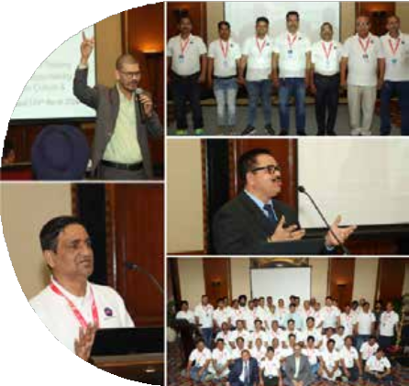
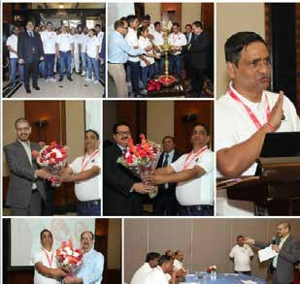
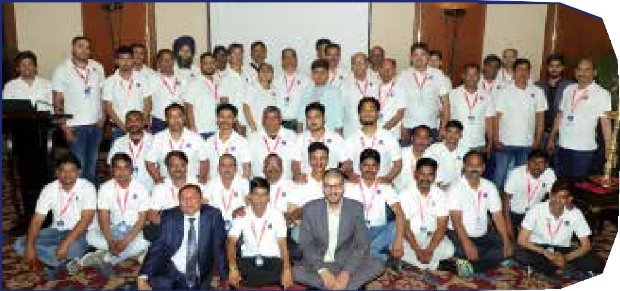
Training and
Certification
At M R Tour and Traders, we prioritize professionalism and excellence in customer service. To ensure that our corporate staff and chauffeurs are equipped with the necessary skills to deliver exceptional service, we offer comprehensive training and certification programs conducted by top-tier trainers in the industry.
We believe in continuous learning and improvement. We also encourage ongoing professional development to ensure our team stays ahead in delivering exceptional service.
At M R Tour and Traders, we are committed to setting the standard for excellence in the hospitality industry. Our training and certification programs empower our team to deliver unparalleled service, ensuring that every client experience is nothing short of exceptional.
Cleanliness & Comfort | Service with Excellence | Sustainability Initiative

Slide 16
Welcome Kit & Services
As part of our commitment to passenger comfort and
Convenience, the M R TOUR & TRADERS team provides
Essential items in our welcome kits during taxi services.
• Drinking Mineral water
• Hand Sanitizer
• Newspaper and Magazine
• First Aid Box

Slide 17
Additional Value
Technology Integration
Offering features like online booking, fare estimates, and real-time tracking enhances convenience for customers.

Slide 18
Thanks
A Lot for your time and attention
For further information & Business enquiries please contact
Office Details:
M R Tours & Traders Pvt Ltd
# 303 - 304, Pankaj Chamber, H Block Market, Sarita Vihar, New Delhi, Pin - 110076
Contact Number:
0091-11-7982591079
0091-11-9350158956
24x7 Helpline Number:
0091-11-45537935
0091-11-7982591079
Business Development
Mr. Ashish Kumar Email:-Ashish.jha@mrtours.in Mobile: 8750961118, 7982591079

